Slide 1
Electric Forces and Fields
Holt Chapter 16
Reading this chapter is strongly recommended

Slide 2
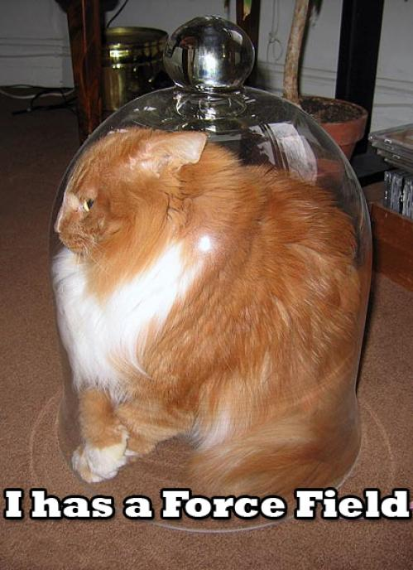
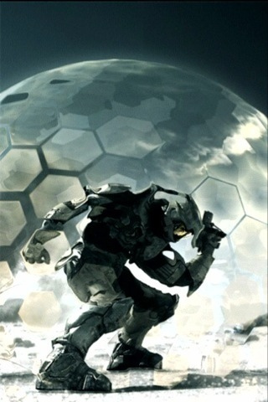
A Brief Review…
Define the following observable quantities:
  Mass
  Energy
  Work
  Momentum
  Charge
What is a force?
  What is a contact force?
  What is a field force?
  What is a force field?

Slide 3
Electric Charge
Chapter 16 Section 1

Slide 4
Properties of Electric Charge
All electric charge is quantized
  Charge comes in packets which cannot be divided
Only two types of electric charge exist
  Positive (protons)
  Negative (electrons)
Opposites attract, likes repel
  Charges can induce forces that cause motion
Charge is always conserved
  The total charge is always the same, but charges can redistribute so that it may appear as though charge is “built up” in an open system

Slide 5

All Electric Charge is Quantized
You can only exchange charge in discrete packets, although it is usually transferred in batches of these packets
  The smallest unit of charge is the amount of charge carried by a single electron (or proton)
  Quantized charge is analogous to our use of money: we can transfer large sums of money, but those large amounts are just lots of pennies
All charge is a multiple of a fundamental unit of charge, symbolized by e
  Electrons  –e
  Protons  +e
  The SI unit of charge is the Coulomb (C)
    e = 1.6 x 10⁻¹⁹ C

Slide 6
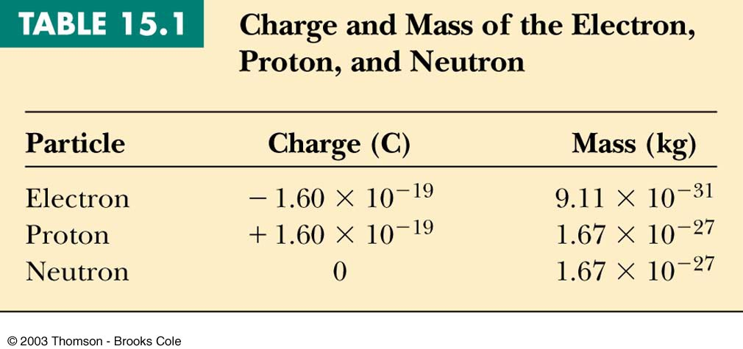
All Electric Charge is Quantized

Slide 7
Two Kinds of Electric Charge
Positive Charge
Negative Charge
Carried by protons
Benjamin Franklin arbitrarily named the two types of charge positive and negative (presumably because it fit with the math)
Carried by electrons
It was later discovered that negative charges were the charges that moved in metals (as opposed to positive flowing) so ideas needed to be negated

Slide 8
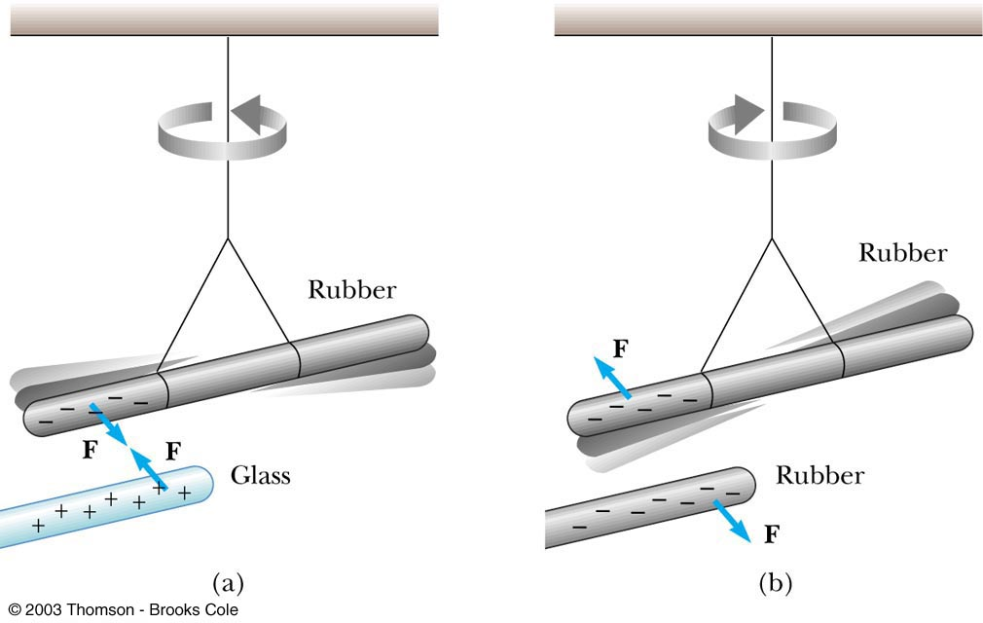
Opposites Attract, Likes Repel

Slide 9
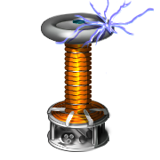
Charges are Always Conserved
Charge is carried by mass (electrons or protons) and since mass must be conserved, charge must be conserved
Charge can be “built up” in an area by collecting a lot of particles of similar charge in an area
  Think of building a sand castle in a sandbox: you move the sand around to make a pile, without changing the total amount of sand in the box

Slide 10
Transfer of Electric Charge
There are occasions where electric charge of one type or another will build up in an area, and this can only be achieved by the movement of charged particles
  Particles of similar type must move to the area to build the charge
  Particles must be able to leave the area to dissipate the charge
Ancient Greeks observed electric and magnetic phenomena as early as 700 BC
    Found that amber, when rubbed, became “electrified” and attracted pieces of straw or feathers

Slide 11
Conductors
Conductors are materials in which the electric charges move freely
  Copper, aluminum and silver are good conductors
  When a conductor is charged in a small region, the charge readily distributes itself over the entire surface of the material

Slide 12
Insulators
Insulators are materials in which electric charges do not move freely
  Glass and rubber are examples of insulators
  When insulators are charged by rubbing, only the rubbed area becomes charged
    There is no tendency for the charge to move into other regions of the material

Slide 13

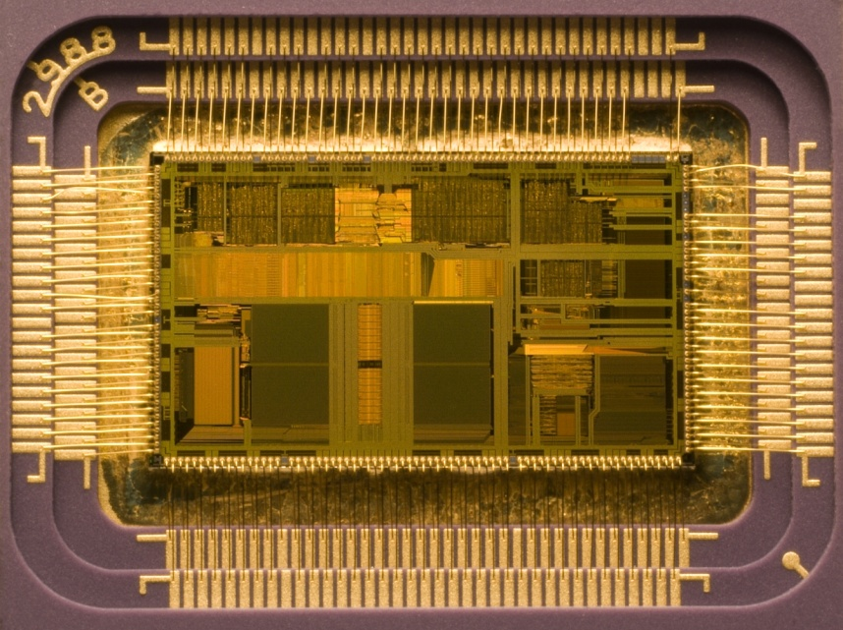
Semiconductors
The characteristics of semiconductors are between those of insulators and conductors
Silicon and germanium are examples of semiconductors

Slide 14
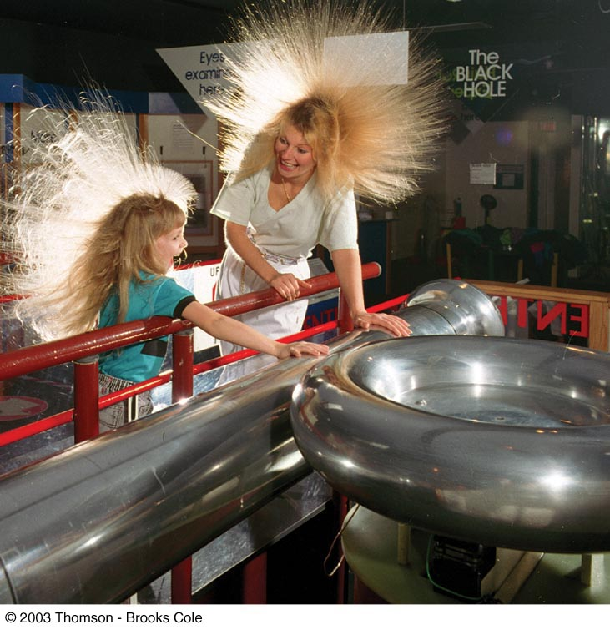
Hair Raising
Electrostatic!
Why are all of the hairs standing on end, in defiance of gravity?
  There is a large build-up of the same charge on the hairs, so the hairs repel and the electric force is enough to overcome gravitation.
Can you tell by this if the person and their hair are conductors or insulators? If so, which are they?
  Why could this be?

Slide 15
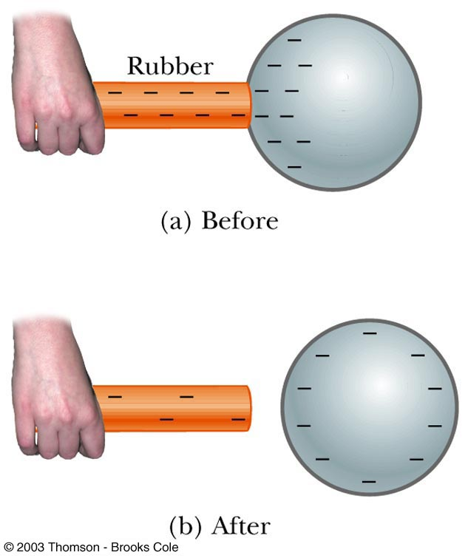
Charging by Conduction
A charged object (the rod) is placed in contact with another object (the sphere)
Some electrons on the rod can move to the sphere
When the rod is removed, the sphere is left with a charge
The object being charged is always left with a charge having the same sign as the object doing the charging

Slide 16
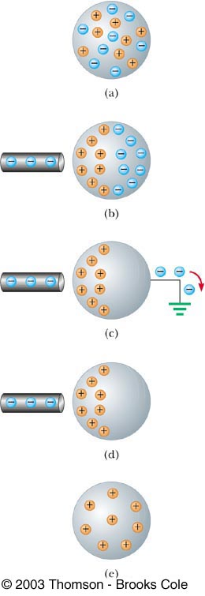
Charging by Induction
A negatively charged rubber rod is brought near an uncharged sphere
The charges in the sphere are redistributed
  Some of the electrons in the sphere are repelled from the electrons in the rod
The wire to ground is removed, the sphere is left with an excess of induced positive charge
The positive charge on the sphere is evenly distributed due to the repulsion between the positive charges
Charging by induction requires no contact with the object inducing the charge

Slide 17
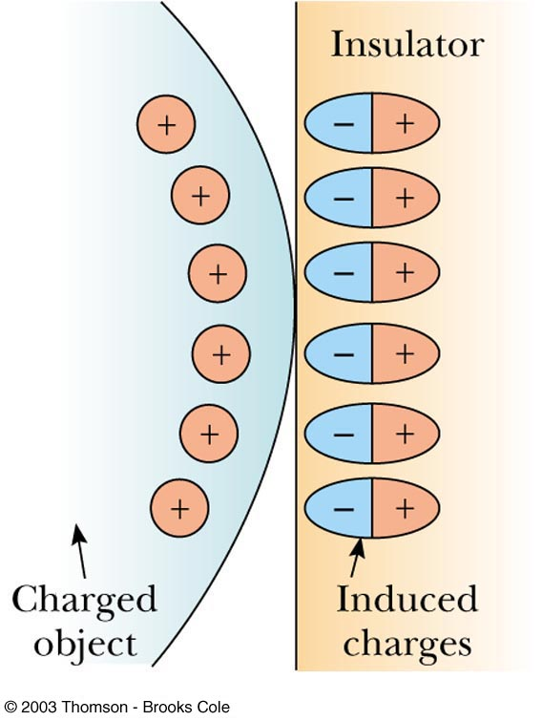
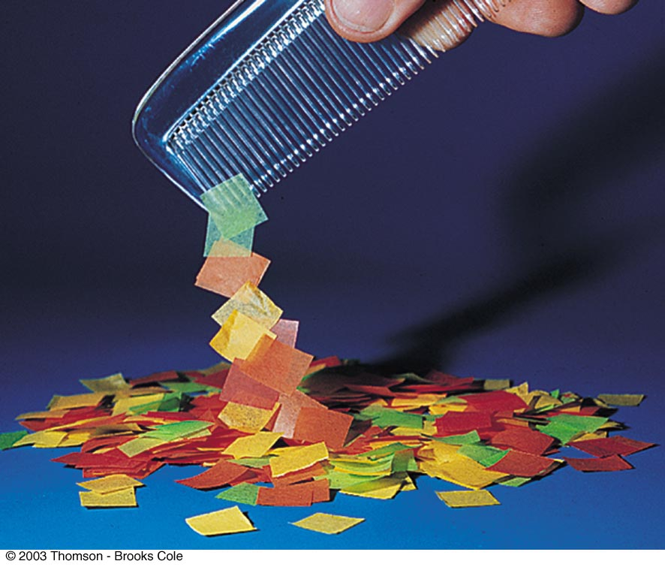
Polarization
In the presence of a charged object, these centers may separate slightly
  This results in more positive charge on one side of the molecule than on the other side
This realignment of charge on the surface of an insulator is known as polarization
  The paper is polarized by the charged plastic comb

Slide 18
Electric Fields
Chapter 16 Section 2

Slide 19
Coulomb’s Law
Charged particles exert an Electric field force on each other that can cause charged particles to move and accelerate, similarly to gravity
  If the force is between oppositely charged particles it is attractive
  If the force is between similarly charged particles it is repulsive
q = charge of particle
r = distance between particles
k_{C} = 8.99×10⁹ Nm²/C²
  The Coulomb Constant
F_{e} = electric force
Sign of F_{e} shows direction
  Positive F_{e} is repulsive
  Negative F_{e} is attractive

Slide 20
Electrical Forces are Field Forces
This is the second example of a field force
  Gravity was the first
Remember, with a field force, the force is exerted by one object on another object even though there is no physical contact between them
There are some important differences between electrical and gravitational forces
  Gravity is always attractive

Slide 21
Attractive or Repulsive?
Two electrostatic point charges of +3C and +4C exert a force on each other of 175N.
Is the force attractive or repulsive?
What is the distance between the two charges?

Slide 22
Electrical Force Compared to Gravitational Force
Similarities
Differences
Both are inverse square laws
The mathematical form of both laws is the same
Electrical forces can be either attractive or repulsive
Gravitational forces are always attractive

Slide 23
Is F_{e} stronger than F_{g}?
The electron and proton of a hydrogen atom are separated, on average, by a distance of about 5.3 x 10⁻¹¹ m. Find the magnitudes of both electrical and gravitational force on each other. (Hint: you’ll need to know the masses and charges of electrons and protons.)

Slide 24
All Electric Charge is Quantized

Slide 25
Is F_{e} really stronger than F_{g}?
The electric force is significantly stronger than the gravitational force. However, although we are attracted to Earth by gravity, we do not usually feel the effects of the electric force.
Explain why…
The net charge of both the Earth and things on it is zero

Slide 26
How is matter made of charges stable?
An ordinary nickel contains about 1×10²⁴ electrons, all repelling one another. Why don’t these electrons fly off the nickel?
The positive charges in the penny hold it together.

Slide 27
How does distance effect the F_{e}?
When the distance between two negatively charged balloons is doubled, by what factor does the repulsive force between them change?
It is weakened to ¼ its original strength.

Slide 28
Vector Nature of Electric Forces
Two point charges are separated by a distance r
The like charges produce a repulsive force between them
The force on q₁ is equal in magnitude and opposite in direction to the force on q₂

Slide 29
Vector Nature of Forces
Two point charges are separated by a distance r
The unlike charges produce a attractive force between them
The force on q₁ is equal in magnitude and opposite in direction to the force on q₂

Slide 30
The Superposition Principle
The resultant force on any one charge equals the vector sum of the forces exerted by the other individual charges that are present.
  Remember to add the forces vectorially

Slide 31
Superposition of Forces (on the line)
Three charges are located on the x-axis. A 5.0 C charge is located at x = 0.0cm, a 1.5 C charge is located at x = 3.0cm, and a -3.0 C charge is located at x = 5.0cm. Find the resultant force on the 5.0 C charge.
2.1×10¹³N Right

Slide 32
Superposition of Forces (on the line)
Three charges lie along the x-axis. One positive charge, q₁ = 15μC, is at the origin, and another positive charge, q₂ = 6μC, is at the at x=1.0m. The third charge is at x=2.5m and has a charge of -3μC. What is the net force felt by the second charge (q₂) at the described location?

Slide 33
Superposition of Forces (net zero)
Two charges, q₁ and q₂, lie on the x-axis. The first charge is at the origin and the second is at x = 1.0m. Charge q₁ has a charge of -4C and q₂ has a charge of 2C. If a -3C charge is placed at x=2.0m, what is the force felt by this third charge?

Slide 34
The Electric Field
Chapter 16 Section 3

Slide 35
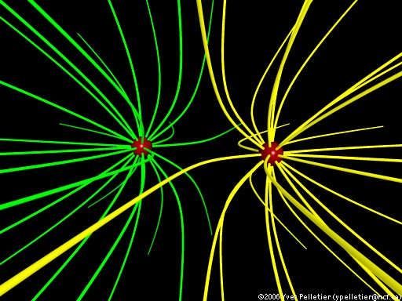
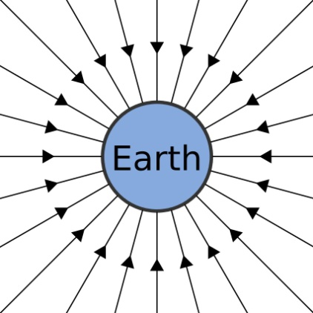
Electric Field Strength
James Clerk Maxwell developed an approach to discussing fields
An electric field is said to exist in the region of space around a charged object
  When another charged object enters this electric field, the field exerts a force on the second charged object
Gravity Field

Slide 36
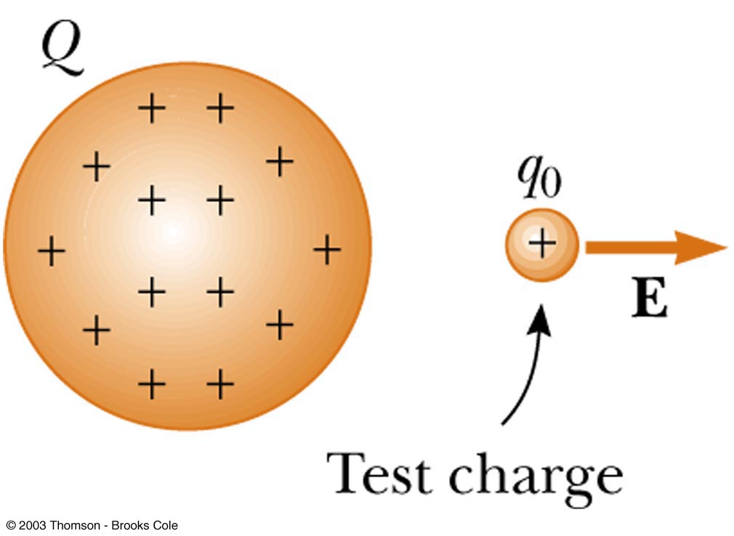
Electric Field Strength
A charged particle, with charge Q, produces an electric field in the region of space around it
A small test charge, q_{o}, placed in the field, will experience a force

Slide 37
Electric Field Strength
Mathematically,
Use this for the magnitude of the field
The electric field is a vector quantity
The direction of the field is defined to be the direction of the electric force that would be exerted on a small positive test charge placed at that point

Slide 38
Ex. 9
An electric field around a charged object is 5.95 x 10⁶ N/C at a distance of 10.0cm. Find the charge on the object.

Slide 39
Direction of Electric Field
The electric field produced by a negative charge is directed toward the charge
  A positive test charge would be attracted to the negative source charge

Slide 40
Direction of Electric Field, cont
The electric field produced by a positive charge is directed away from the charge
  A positive test charge would be repelled from the positive source charge

Slide 41
Superposition of Electric Fields
If you have multiple charges that create electric fields that overlap, the field in those overlapping areas are the sum of both field vectors
+
-

Slide 42
Ex. 9
A charge q₁ = 7 C is at the origin, and a charge q₂ = -5 C is on the x-axis .3m from the origin. Find the electric field strength at point P, which is on the y-axis 0.400m from the origin.

Slide 43
Electric Field Lines
A convenient aid for visualizing electric field patterns is to draw lines pointing in the direction of the field vector at any point
These are called electric field lines and were introduced by Michael Faraday

Slide 44
Electric Field Lines
The field lines are related to the field by
  The electric field vector, E, is tangent to the electric field lines at each point
  The number of lines per unit area through a surface perpendicular to the lines is proportional to the strength of the electric field in a given region

Slide 45
Electric Field Line Patterns
Point charge
The lines radiate equally in all directions
For a positive source charge, the lines will radiate outward

Slide 46
Electric Field Line Patterns
For a negative source charge, the lines will point inward

Slide 47
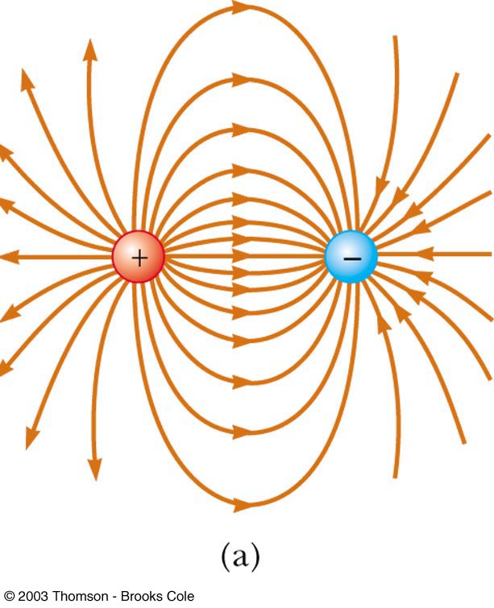
Electric Field Line Patterns
An electric dipole consists of two equal and opposite charges
The high density of lines between the charges indicates the strong electric field in this region

Slide 48
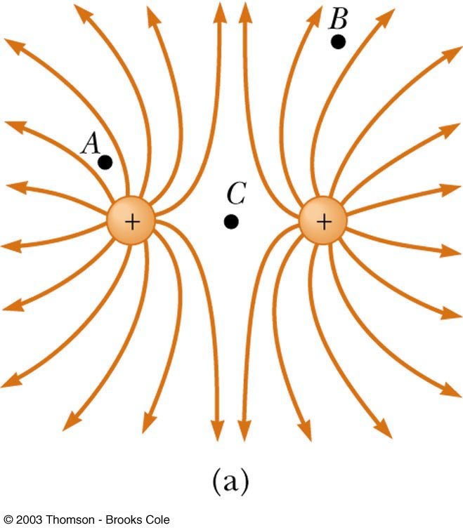
Electric Field Line Patterns
Two equal but like point charges
At a great distance from the charges, the field would be approximately that of a single charge of 2q
The bulging out of the field lines between the charges indicates the repulsion between the charges
The low field lines between the charges indicates a weak field in this region

Slide 49
Rules for Drawing Electric Field Lines
The lines for a group of charges must begin on positive charges and end on negative charges
  In the case of an excess of charge, some lines will begin or end infinitely far away
The number of lines drawn leaving a positive charge or ending on a negative charge is proportional to the magnitude of the charge
No two field lines can cross each other

Slide 50
Rank the magnitudes of the electric field at points A, B, and C in the figure below, largest magnitude first.
QUICK QUIZ 15.7

Slide 51
A, B, and C. The field is greatest at point A because this is where the field lines are closest together. The absence of lines at point C indicates that the electric field there is zero.
QUICK QUIZ 15.7 ANSWER

Slide 52
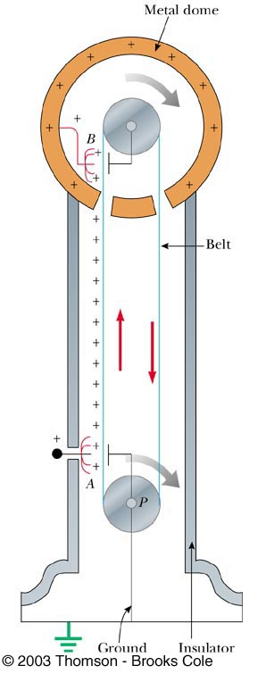
Van de Graaff
Generator
An electrostatic generator designed and built by Robert J. Van de Graaff in 1929
Charge is transferred to the dome by means of a rotating belt
Eventually an electrostatic discharge takes place

Slide 53
Conductors in Electrostatic Equilibrium

Slide 54
Electric Potential
Holt Chapter 17 Section 1

Slide 55
Electrical Potential Energy
Electrical Potential Energy: Potential energy associated with a charge because of an electric field’s ability to do work on it
  This is dastardly similar to gravitational potential energy, which we discussed long ago…
Electrical Potential Energy (U_{electric} or PE_{electric}) is a part of mechanical energy and can be grouped with gravitational or elastic potential
Potential energy can be easily calculated in a uniform electric field using the equation:
Very Similar 

Slide 56
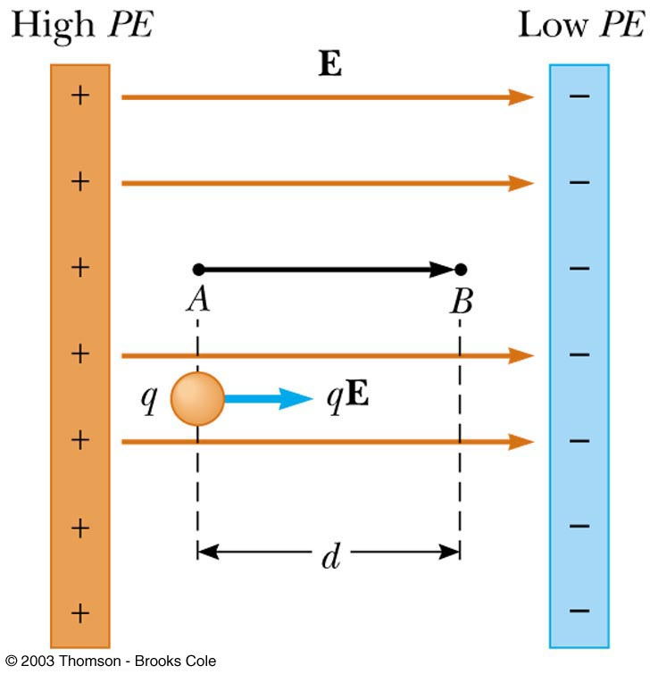
Work and Potential Energy
There is a uniform field between the two plates
As the charge moves from A to B, work is done in it
Remember the Work-Energy Theorem
  W = ΔE_{k} = -ΔU

Slide 57
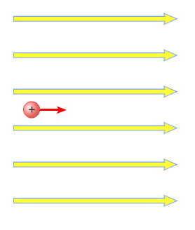
Electrical Potential Energy
Potential energy can be easily calculated in a uniform electric field using the equation:
E
Very Similar 
A
B
A positive charge moves from point A to B in a uniform electric field, and the potential energy changes as a result
d

Slide 58
A Quick Proof of Electrical Potential Energy and Analogy to U_{g}
Blue Border Slides are ‘brain candy’ and not necessary notes
The Equation for Electrical Potential Energy has some surprising roots:
  The Work-Energy Theorem
  The Definition of Work
  Redefine Work with F=ma
  Sub -ΔU for work
  The basic units are analogous 
  Gravity & E-fields are analogous 

Slide 59
Electric Potential
Potential energy is a useful concept, but it is more convenient to describe it without charge
Electric Potential: The potential energy of a particle in a field divided by the charge of the particle (this is better for handling flow of charge)
  This definition means that electric potential is like potential energy, but independent of charge
  Electric potential uses the unit: Volts (V)
    Volts are derived units that can be made many ways

Slide 60
Potential Difference
Potential:

